Slide 1

Arduino-Based Temperature Monitoring: Daily
Peaks and Time Ranges
D.KARTHIK
SURE TRUST

Slide 2
TMP36 Temperature Sensor :
The TMP36 is a low voltage, precision centigrade temperature sensor manufactured by Analog
Devices.
It is a chip that provides a voltage output that is linearly proportional to the temperature in °C
The TMP36 temperature sensor is fairly precise, never wears out, works under many
environmental conditions and requires no external components to work.
In addition, the TMP36 sensor does not require calibration and provides a typical accuracy of ±1°C at +25°C and ±2°C over the −40°C to +125°C temperature range.

Slide 3
Specifications of tmp36 sensor:
Power supply 2.7V to 5.5V
Current draw 50µA
Temperature range -40°C to 125°C
Accuracy ±2°C
Output scale factor 10mV/°C
Output range 0.1V (-40°C) to 1.75V (125°C)
Output at 25°C750mV

Slide 4
Measuring Temperature:
The TMP36 is easy to use, just connect the left pin to power (2.7-5.5V)
and the right pin to ground (assuming the flat side of the sensor is
facing you).
Then the middle pin will have an analog voltage that is directly
proportional (linear) to the temperature in °C.
To convert the voltage to temperature, simply use the basic formula:
Temp (°C) = (Vout – 0.5) * 100
for example, if the voltage out is 1V that means that the temperature is
(1 – 0.5) * 100 = 50 °C.
Before calculating the temperature reading, we subtract 0.5V from the output voltage because the TMP36 has a 500mV offset. This offset is what gives the sensor the ability to read negative temperatures. Now to convert this voltage in to temperature, we simply multiply it by 100 because the TMP36 has a scaling factor of 10mV/°C. As easy as ABC.

Slide 5
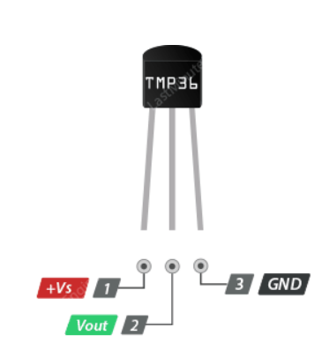
TMP36 Sensor Pinout:
+Vs is the power supply for the sensor which can be anywhere between 2.7V to 5.5V.
Vout pin produces an analog voltage that is directly proportional (linear) to the temperature. It should be connected to an Analog (ADC) input.
GND is a ground pin.

Slide 6
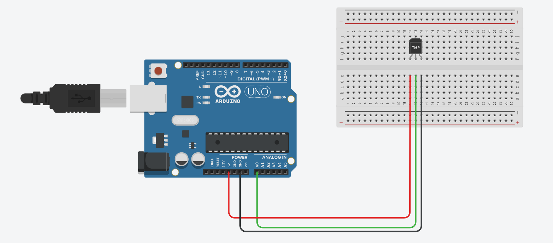
Connecting the TMP36 Tempera ture Sensor to an Arduino:
Hooking up the TMP36 to an Arduino is super simple. You only need to connect
three pins: two for power and one for reading the sensor value.
The sensor can be powered from 3.3 or 5V output. The positive voltage connects
to ‘+Vs’ and ground connects to ‘GND‘. The middle pin ‘Vout’ is the analog signal output from the sensor and connects to the A0 analog input of an Arduino.

Slide 7
Reading the Analog Temperature Data:
As you can see in the wiring diagram above, the output of the TMP36 is
connected to one of the analog inputs of the Arduino.
The value of this analog input can be read with the analogRead() function.
However, the analogRead() function does not actually return the output voltage of the sensor. Instead it maps the input voltage between 0 and the ADC
reference voltage (technically it is the operating voltage i.e. 5V or 3.3V ) to
10-bit integer values ​​ranging from 0 to 1023.
To Convert analog reading to Celsius , use this formula:
totalTemp += analogRead(tempePin) *(5/1024)

Slide 8
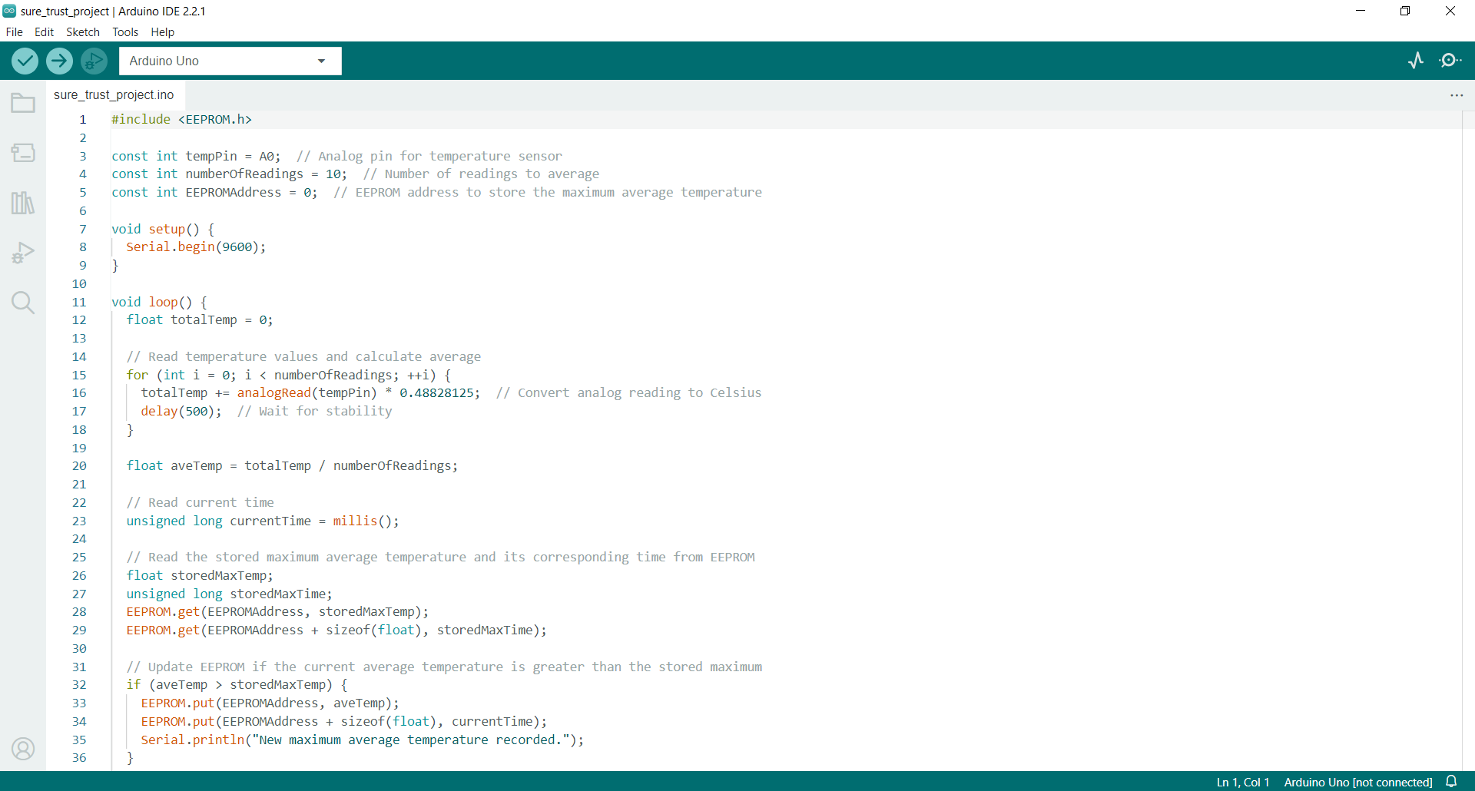
Arduino Code:

Slide 9
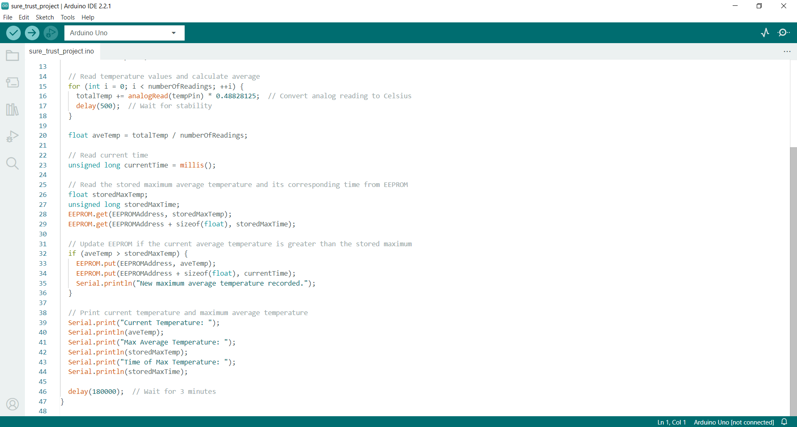
Arduino Code:

Slide 10
Arduino Code Explanation:
#include <EEPROM.h>
This line includes the EEPROM library, which is used to read and write
data to the non-volatile memory (EEPROM) on the Arduino.
const int tempPin = A0;
This line defines a constant variable temperaturePin and sets it to the value of A0, which is the analog pin to which the temperature sensor is
connected.
const int numberOfReadings = 3;
This line defines a constant variable numberOfReadings and sets it to 3,
representing the number of temperature readings to be averaged.
const int EEPROMAddress = 0;
This line defines a constant variable EEPROMAddress and sets it to 0, representing the EEPROM address where the maximum average temperature will be stored.

Slide 11
Arduino Code Explanation:
void setup() { Serial.begin(9600); }
This is the setup function, which runs once when the Arduino starts. It
initializes serial communication with a baud rate of 9600, allowing you to communicate with the Arduino through the Serial Monitor in the Arduino IDE.
void loop() {
float totalTemp = 0;
for (int i = 0; i < numberOfReadings; ++i) {
totalTemp += analogRead(tempPin) *(5/1023);
delay(500); }
This is the main loop function that runs repeatedly. It initializes a variable totalTemperature and then enters a loop to read the temperature values
numberOfReadings times. The analog readings from the temperature
sensor are converted to Celsius and added to totalTemperature. A delay is used for stability.

Slide 12
Arduino Code Explanation:
float aveTemp = totalTemp / numberOfReadings;
After the loop, the average temperature is calculated by dividing the total
temperature by the number of readings.
unsigned long currentTime = millis();
The current time in milliseconds since the Arduino started is obtained
using the millis() function.
float storedMaxTemp;
unsigned long storedMaxTime; Declares two variables
EEPROM.get(EEPROMAddress, storedMaxTemp);
EEPROM.get(EEPROMAddress + sizeof(float), storedMaxTime);
The first line retrieves the stored maximum temperature from the EEPROM
address specified by EEPROMAddress. The second line retrieves the timestap, which is stored in the EEPROM immediately after the maximum temperature. storedMaxTemp will contain the previously stored maximum temperature, and storedMaxTime will contain the corresponding timestamp.

Slide 13
Arduino Code Explanation:
if (averageTemperature > storedMaxTemperature) {
his line checks whether the averageTemperature is greater than the storedMaxTemperature. If this condition is true, it means that a new maximum temperature has been reached.
EEPROM.put(EEPROMAddress, averageTemperature);
EEPROM.put(EEPROMAddress + sizeof(float), currentTime);
If the condition is true, it writes the averageTemperature to the EEPROM at the
specified EEPROMAddress. It also writes the currentTime to the next EEPROM
address. The sizeof(float) is used to determine the size of the float data type,
ensuring proper alignment.
Serial.println("New maximum average temperature recorded."); }
Serial.print("Current Temperature: ");
Serial.println(averageTemperature);
Serial.print("Max Average Temperature: ");
Serial.println(storedMaxTemperature);
Serial.print("Time of Max Temperature: ");
Serial.println(storedMaxTime);
delay(1000); }
A message is printed to the Serial Monitor.Precise time delay between two action

Slide 14
Arduino Code Output:
Current Temperature: 74.71
Max Average Temperature: 74.71
Time of Max Temperature: 5001
New maximum average temperature recorded.
Current Temperature: 121.09
Max Average Temperature: 74.71
Time of Max Temperature: 5001
Current Temperature: 49.80
Max Average Temperature: 121.09
Time of Max Temperature: 47262
New maximum average temperature recorded.
Current Temperature: 136.52
Max Average Temperature: 121.09
Time of Max Temperature: 47262

Slide 15
Advantages:
Real-Time Monitoring: The project provides real-time monitoring of temperature variations during the day, allowing for timely insights into environmental changes.
Data Logging: Arduino allows for efficient data logging, enabling the recording of temperature values at regular intervals. This data can be used for analysis and
future reference.
Automation: The system automates the process of temperature monitoring,
eliminating the need for manual data collection and providing a continuous
stream of information.
Accuracy: By using a temperature sensor and Arduino, the project can provide
accurate temperature readings, offering reliable information for analysis.
Time-Stamped Records: The inclusion of time-stamped records allows for precise identification of when temperature peaks occur, aiding in the understanding of
daily temperature patterns.
Cost-Effective: Arduino is a cost-effective platform for creating monitoring
systems, making the project accessible for DIY enthusiasts and researchers with
limited budgets.

Slide 16
Disadvantages:
No Digital Output: Unlike some digital temperature sensors, the TMP36
provides an analog output. This means you may need to perform
additional analog-to-digital conversion (ADC)
Dependency on Power: The system relies on a continuous power supply
for operation. In case of power outages, the monitoring process may be
interrupted.
Localization: The project's usefulness might be limited to a specific
location due to the environmental conditions and temperature ranges it is designed to monitor.
Data Storage Capacity: EEPROM on Arduino has limited storage capacity. If there's a need for long-term data storage or extensive logging, an
external storage solution may be necessary.
Weather Conditions: Extreme weather conditions might impact the reliability of the sensor or introduce additional variables that affect temperature readings.

Slide 17
Applications:
Home Automation:
Implementing a smart thermostat system that learns about the temperature patterns in a house can help optimize heating and cooling systems. By recording the time range of maximum average temperatures, the system can adjust temperature
settings for better energy efficiency.
Crop Monitoring in Agriculture:
Farmers can use temperature data to monitor the microclimate in specific fields. By identifying the time range of maximum average temperatures, farmers can plan
irrigation, pest control, and other agricultural activities more effectively.
Health and Safety:
Monitoring temperature variations in certain environments, such as laboratories or medical storage areas, is crucial for preserving samples or medicines. Identifying
the time range of maximum average temperatures ensures that conditions remain within the required range for safety and effectiveness.
Greenhouses:
Monitoring temperature variations in a greenhouse is crucial for plant growth. By
tracking the time range of maximum average temperatures, you can optimize
climate control systems to ensure that plants receive the ideal temperature
conditions for growth.

